Slide 1
IBCSG Trial 55-17
TOUCH
Phase II open-label, multicenter, randomized trial of neoadjuvant palbociclib in combination with hormonal therapy and HER2 blockade versus paclitaxel in combination with HER2 blockade for postmenopausal patients with hormone receptor positive/HER2 positive early breast cancer
International Breast Cancer Study Group
Susan Fischer, Lead Data Manager
July 2020 Includes Amendment 1

Slide 2
TOUCH IBCSG Contacts

Slide 3
TOUCH Study Contacts
Trial Monitors:
Giuseppe Achille
Daniela Celotto
Carmen Comune
Magdalena Sanchez-Hohl
Mariana Pardo Contreras
Lionel Nobs
Fabienne Wyss
Trial Coordinator:
Meredith Kissel
Data Manager:
Susan Fischer
ibcsg55_touch@frontierscience.org

Slide 4
Touch Study Contacts
IBCSG Coordinating Center
Bern, Switzerland
Drug Supply Office
Linda Fritzsche
Phone: +41 31 511 94 00
Fax: +41 31 511 94 01
drugsupply@ibcsg.org
Regulatory Office
Barbara Ruepp, PharmD
Rita Pfister
regulatoryoffice@ibcsg.org
Safety Office
safetyoffice@ibcsg.org
Phone +41 31 389 92 28 or +41 31 389 92 22
Fax : +41 31 389 92 29
SAE Medical Review:
Dr. Manuela Rabaglio, MD
SAE General Management:
Dr. Barbara Ruepp, PharmD

Slide 5
Conducting Clinical Trials with the IBCSG

Slide 6
Center Activation
Prior to activating your Center, the Data Management Center should have obtained the following documents:
  The Ethics Committee (EC) approval, containing the EC member list (all names) and the list of members who were present for the approval (copy).
  The Health Authority (HA/CA) approval (copy)
  Hospital Administration approval, if applicable (copy)
  Patient Information Sheet and Informed Consent (PIS/IC), in the language(s) of the patient, approved by your EC (copy).
  Principal Investigator Protocol Signature Page, signed by the PI (original)
  Obvious Corrections Signature Page, signed by the PI (original)
  Center Information Sheet (copy)
  Laboratory Certificate and Values (copy)
  Authorization Log (copy) – Surgeons should be listed on the Authorization Log
  Principal Investigator’s and Trial Staff CV & GCP documents(copy, dated and signed) if not submitted within the last two years
  GCP training certificates of the PI and Co-Investigators (if available)
  Signed subcontract (original)

Slide 7
DFexplore
The eCRF used in IBCSG trials is DFexplore
It is mandatory to use this system for all data submission to IBCSG.
Prior to Center activation, you must ensure this program can be installed on the computers at your Center.

Slide 8
Center Activation
When a Center has completed the regulatory procedures, provided all necessary documents, and completed training, IBCSG will authorize the Center for activation and patient enrollment
Each Center will receive a Confirmation of Activation email from the DMC notifying them that they are approved for enrolling patients
  IMPORTANT: Print and save this email in your TOUCH Investigator File

Slide 9
Contact Changes
Any changes in staff at your Center should be reported to the IBCSG Trial Coordinators and the site Monitor immediately
Submit the updated documents below:
  Contact details on Center Information Sheet
  Authorization Log
  Signed and dated CV (within 2 years)
  GCP certificates (if applicable)

Slide 10
Training for New Staff
If you would like a TOUCH training for any new staff, please contact the DMC TOUCH Team and the IBCSG Center Training Office:
  ibcsg55_touch@frontierscience.org
  ibcsg.training@frontierscience.org

Slide 11
Handling PI changes
If the Principal Investigator withdraws for any reason(s) before completion of the trial, a suitably qualified successor should be appointed to take over responsibility for the conduct of the study.
Any changes in PI should be communicated to IBCSG staff immediately.

Slide 12
Please note:
Any deviation from the protocol or lack of timely EC submission/incomplete completion of IC can result in a non coverage by the insurance!

Slide 13
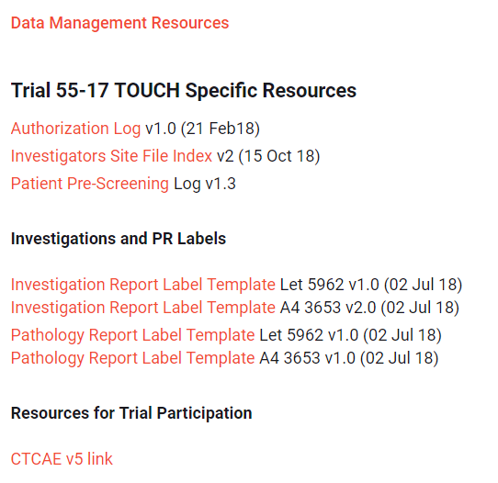
Investigator File
It is essential that all Centers utilize the IBCSG Investigator Site File Index.
  This document is available via the IBCSG 55-17 TOUCH website

Slide 14
TOUCH Highlights

Slide 15
Phase II trial
Enrollment: 144 patients
Randomization expected over 24 months, trial ends 12 months after last patient enrolled
Final analysis expected 42 months after inclusion of first patient
Patients enrolled at 50 sites in Belgium, France, Italy, and Switzerland

Slide 16
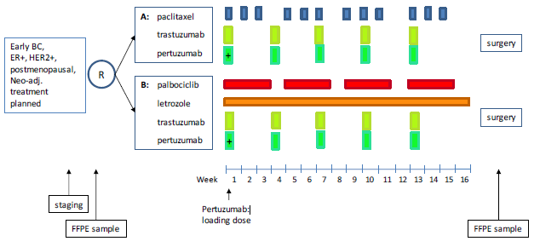
Schema

Slide 17
Primary Objective
Explore the interaction between pre-treatment tumor RBsig status and treatment activity of palbociclib+letrozole versus paclitaxel, when given with trastuzumab+pertuzumab, for ER+/HER2+ primary breast cancer
  RBsig is a gene expression signature, determined from RNA extracted from the diagnostic breast core biopsy specimen
Primary endpoint:
  pCR (pathologic complete response), defined as absence of invasive tumor cells in the breast and in the axillary lymph nodes at the time of surgery (ypT0/ypTis ypN0)

Slide 18
Secondary Objectives
pCR in breast only (ypT0/ypTis)
Objective response prior to surgery, defined as partial or complete response assessed clinically and by ultrasound and/or mammography
Tolerability: Adverse events according to CTCAE version 5
Rate of Breast-Conserving Surgery (BCS)

Slide 19
Inclusion/Exclusion

Slide 20
Inclusion Criteria
Histologically confirmed invasive breast cancer, with the following characteristics:
  Early breast cancer with tumor size > 1 cm (as measured by at least one of the required examination methods of clinical examination, mammography and ultrasonography)
  No clinical evidence of regional lymph node metastasis (via physical and/or radiological exam (cN0)) OR
  Clinical evidence of cN1 status, defined by nodal involvement limited to clinically or radiologically detectable metastasis to movable ipsilateral level I, II axillary lymph node(s)
  No evidence of metastasis (M0)
Female postmenopausal patients
*Note to French Centers: Early breast cancer with tumor size > 2 cm.
Female aged 70 years or older.
Patients must have national social insurance coverage.

Slide 21
Postmenopausal Definition
  Postmenopausal, defined as women with:
  Prior bilateral surgical oophorectomy; OR
  Amenorrhea and age >60 years; OR
  Age <60 years and amenorrhea for 12 or more consecutive months in the absence of alternative pathological or physiological cause (including chemotherapy, tamoxifen, toremifene, ovarian suppression, or hormonally-based contraception) plus FSH and serum estradiol levels within the laboratory’s reference ranges for post-menopausal women

Slide 22
Inclusion Criteria (continued)
Primary tumor must have positive estrogen receptor (ER) ≥10%
Primary tumor must be HER2-positive (by IHC and/or ISH)
Baseline LVEF ≥55% measured by Echocardiography (preferred) or MUGA scan
Normal hematologic status, renal function, liver function

Slide 23
Exclusion Criteria
Tumor of any size with direct extension to the chest wall and/or to the skin (ulceration or skin nodules) (T4 according to AJCC cancer staging TNM)
Inflammatory breast cancer
Bilateral invasive breast cancer
Received any prior treatment for primary invasive breast cancer

Slide 24
Exclusion Criteria
Evidence via physical and/or radiological exam of cN2 or cN3 nodal involvement defined by: metastasis to ipsilateral level I, II axillary lymph nodes that are clinically fixed or matted, OR involvement of ipsilateral infraclavicular, internal mammary and/or supraclavicular lymph node(s)
History of extensive disseminated/bilateral or known presence of interstitial fibrosis or interstitial lung disease, including a history of pneumonitis, hypersensitivity pneumonitis, interstitial pneumonia, obliterative bronchiolitis, and pulmonary fibrosis. History of prior radiation pneumonitis is not an exclusion criterion.

Slide 25
Exclusion Criteria (continued)
Any of the following in the previous 6 months:
  Myocardial infarction
  Severe/unstable angina pectoris
  Ongoing cardiac dysrhythmias of NCI CTCAE grade ≥2
  Atrial fibrillation of any grade
  Coronary/peripheral artery bypass graft
  Symptomatic congestive heart failure (NYHA functional classification ≥II)
  Cerebrovascular accident including transient ischemic attack
  Symptomatic pulmonary embolism
  *Note to French Centers: Persons deprived of their liberty or under protective custody or guardianship

Slide 26
Geriatric Assessments (for patients aged >65 years)
Three geriatric assessments are used in this study (completed at baseline):
  G8: 7 items from Mini Nutritional Assessment plus age
  IADL: instrumental activities of daily living
  Charlson Comorbidity Index
Note to Italian Centers: For patients with a G8 score of <14, the minimal Geriatric Core DatasET G-CODE [Paillaud et al 2018] should be completed in addition to the forms above.

Slide 27
Geriatric Assessments (for patients aged >65 years)
The G8 and IADL questionnaires are available in the local language(s) on the IBCSG website.
  Complete both of these questionnaires on paper with the patient by reading the questions to the patient and if necessary explain them further.
  The information will need to be submitted via DFsend within one week of randomization.
  The Charlson Comorbidity Index is in the patient binder in DFexplore.
G8 Score
  This is a stratification factor for patient age >65y; patient cannot be randomized without entering the score in the randomization system
Important!

Slide 28
Pathology Material Submission

Slide 29
Pathology Material Submission
CRUCIAL:
Central RBsig status assessment is mandatory for this trial.
Central Pathology Review of ER and RB1 pathway by IHC and FISH
Mandatory submission of FFPE tumor tissue blocks:
    Diagnostic breast core biopsy taken prior to start of treatment
    Final breast surgical specimen (unless no residual invasive tumor is found at surgery) from definitive surgery
  If this is not possible, the patient should not be enrolled on this trial!
The RBsig status determined from the diagnostic core biopsy specimen is necessary to answer the primary trial research question

Slide 30
Pathology Material Submission
Patient must agree in writing to make mandatory tumor samples available for submission for central pathology review and to conduct translational studies as part of this protocol
FFPE blocks and copies of anonymized Pathology Reports must be marked with the IBCSG Patient ID number and as per protocol, must be submitted to CPO within 4 weeks of specimen collection.
  Detailed collection of these blocks and reports is in the Logistics Manual.

Slide 31
Trial Schedules

Slide 32
protocol treatment
Anti-HER2 treatment:
  Trastuzumab: 600 mg sc every 3 weeks for a total of 5 doses
  Pertuzumab: 840 mg i.v. loading dose followed by 420 mg i.v. every 3 weeks for a total of 5 doses
PLUS
Arm A
  Paclitaxel: 80 mg/m2 i.v. day 1, 8, 15 every 28 days, 4 cycles
  OR
Arm B
  Palbociclib: 125 mg/day orally for 21 days followed by 7 days rest for four 28-day cycles
  Letrozole: 2.5 mg/day orally for sixteen weeks
→ Patient will then proceed to surgery (No later than 4 weeks after the final dose of any of the drugs in the combinations described above)
→ Patient’s participation ends 30 days after surgery

Slide 33
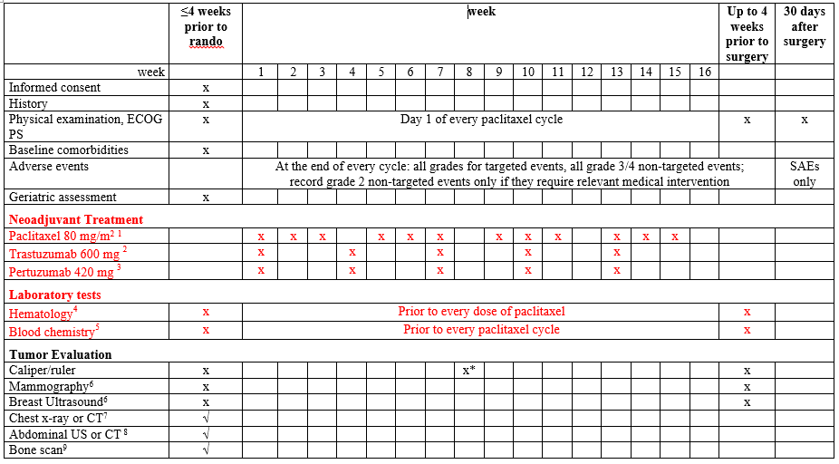
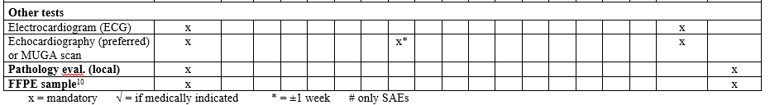
Arm A (paclitaxel, trastuzumab, pertuzumab)

Slide 34
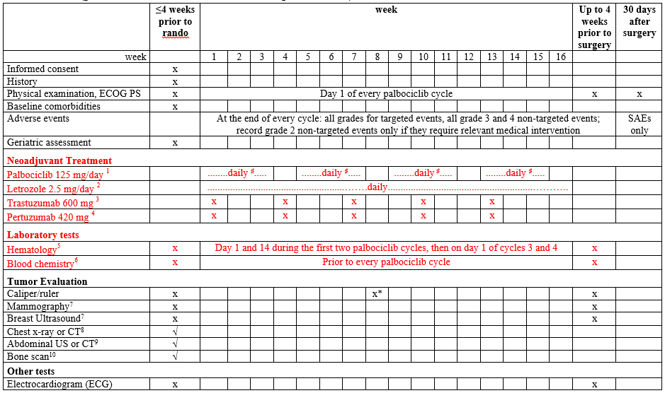

Arm B (palbociclib, letrozole, trastuzumab, pertuzumab)

Slide 35
Floating vs Non-Floating Schedule
Arm A – Floating Schedule
Arm B – Non-Floating Schedule
Paciltaxel is given on days 1, 8 and 15 of a 28 day cycle. If it is given off schedule, the cycle needs to be readjusted to reflect the number of days off schedule.
Medications are taken at various schedules, but are still counted in a 28 day time frame. Patient diary completed for each medication.

Slide 36
Trial Treatment
Trial treatment should start within one week after randomization. Trial treatments will be administered in four 28-day cycles, or until protocol treatment is discontinued (see Section 10.8).
Treatment administration should comply with the protocol; compliance will be monitored by the Monitoring Team and Data Management Center. Complete details of dispensation and dosing are recorded on the eCRF.
Treatment administration for each drug is found within Section 10.2 of the protocol

Slide 37
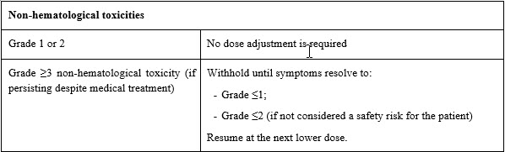
Dose Modifications and Delays
Dose reduction levels for each drug are located within Section 10.3 of the protocol
Dose modifications (adjustments) based on AE/SAEs are also listed within this section by drug.
Example from Palbociclib dose modification chart

Slide 38
Dose Modifications and Delays for Palbociclib
Monitor patients for pulmonary symptoms indicative of ILD/pneumonitis (e.g. hypoxia, cough, dyspnea). In patients who have new or worsening respiratory symptoms and are suspected to have developed ILD/pneumonitis, interrupt palbociclib immediately and evaluate the patient.
Permanently discontinue palbociclib in patients with severe ILD or pneumonitis.

Slide 39
Concomitant Therapy
The following rules should be followed for both treatment arms:
  Anti-cancer (cytotoxic or endocrine therapy, other than letrozole and paclitaxel provided within the trial protocol) or any other investigational therapy is not permitted while patients are on trial therapy.
  Radiotherapy is not permitted while patients are on trial therapy.
The use of other concomitant medication/therapy judged by the Investigator to be necessary for the care of the patient is permitted.
    The patient to notify the trial site about any new medications she takes after the start of the trial drug.
Concomitant medications need to be recorded as follows:
  At baseline, prior to start of treatment, medications or treatments for comorbidities should be recorded on the History form 55-H.
  In case of an SAE, all concomitant medication used to treat the SAE must be reported on the SAE form (55-SAE-B).

Slide 40
RANDOMIZATION

Slide 41
Randomization Steps
Complete the following steps to randomize a patient on this trial.
  Verify eligibility
  Obtain written informed consent both for the clinical trial and the pathology material submission, signed and dated by the patient and Investigator. Informed consent must be obtained prior to any trial-specific screening procedure or intervention.
For patients aged >65 years, geriatric assessments will also need to be completed at this time to complete the randomization process
These are:
  Geriatric Assessment G8 questionnaire (55-G8)
  Lawton Instrumental Activities of Daily Living Scale (55-IADL)

Slide 42
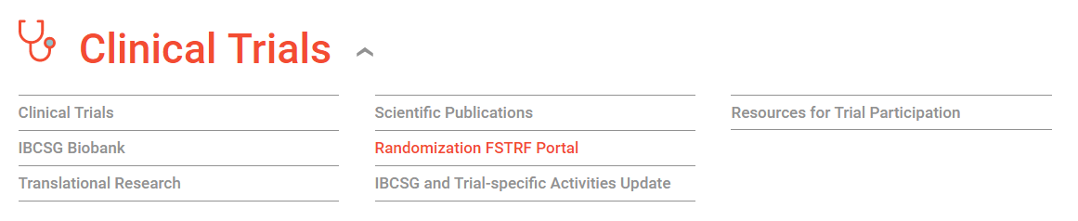
Randomization Steps
Connect to http://www.ibcsg.org
Log in using your IBCSG user name and password.
Click on the RANDOMIZATION FSTRF Portal link

Slide 43
Randomization steps
The Randomization System will provide the following information via e-mail:
  Patient ID (randomization number)
  Treatment assignment
  Date of randomization
  Patient Schedule
  Submit the Confirmation of Randomization (55-A) electronic case report form (eCRF) via DFexplore.
    The patient binder of eCRFs will be available in DFexplore within 24 hours of successful randomization.

Slide 44

CRF Schedule

Slide 45
Baseline
History Form (55-H)
Charlson Comorbidity Index (55-CCI)
Tumor Evaluation Baseline Form (55-TEV-B)
Pre-treatment Pathology Report (55-Pathology Report) - Submit the Biopsy Report to DFexplore via DFsend
All due within one week of randomization!

Slide 46
During Neoadjuvant Treatment
Arms A and B Trastuzumab / Pertuzumab Log (55-TP)
Arm A Paclitaxel Form (55-PAC)
Arm B Palbociclib Form (55-PALBO)
Arm B Letrozole Form (55-LET)
Adverse Events Form (55-AE)
Tumor Evaluation Physical Exam Form - Complete after 2 cycles of Arm A paclitaxel or Arm B palbociclib (Form 55-TEV-PHYS)
Tumor Evaluation Pre-Surgery Form (55-TEV-PreSx) - Complete in DFexplore within 28 days after protocol treatment stops but prior to surgery

Slide 47
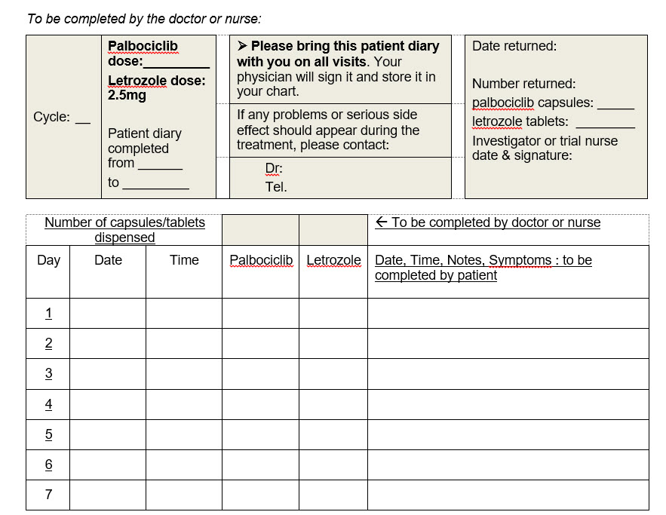
Patient Diary
ARM B only
Should be checked at each visit; hand out new patient diary for next cycle; the diary is not submitted to DFexplore but must be kept in the patient file
Complete this section of the heading before patient leaves clinic
Complete when collected; be sure to complete the details for both drugs; signatures required
Instruct the patient to complete each time they take their medication to ensure accuracy

Slide 48
Surgery
Surgery Form (55-C)- Complete in DFexplore within 2 weeks after surgery
Pathology Form (55-P)- Complete in DFexplore within 2 weeks after surgery
Pathology Report - Submit the Pathology Report for definitive surgery to DFexplore, via DFsend, within 2 weeks after surgery

Slide 49
Discontinuation of Protocol Medication
All trial medication of the individual patient has to stop in case of:
  Disease progression as defined in Section 13 of the protocol
  Unacceptable adverse event(s)
  Patient demonstrates an inability or unwillingness to comply with the treatment regimen and/or trial requirements
  Patient withdraws consent to continue protocol treatment
Patients who discontinue all trial medications early for any reason should proceed to surgery
After the discontinuation of all trial medications, future therapeutic decisions are at the discretion of the Investigator, with no restrictions

Slide 50
End of Medication vs End of Treatment
End of Medication
End of Treatment
Last dose of trial medication
Is defined as the final visit.
  Complete an EoT form for the final visit in DFexplore 30 days after surgery or, if no surgery, 30 days after ALL protocol treatment stops

Slide 51
Safety, AE and SAE reporting

Slide 52
Safety
Trial Drug formulation and handling information
  Protocol Section 9
Adverse Events by drug
  Protocol Section 11
Potential cases of drug-induced liver injury (Hy’s Law cases) are considered an Adverse Events of Special Interest (AESI) and need to be notified to IBCSG immediately (within 24h), following the SAE reporting procedure
  Protocol Section 11.6
Drug to Drug interactions
  Protocol Section 11.7

Slide 53
Trial Safety
The rights, safety and well being of the patient is paramount in every IBCSG trial.
Details on trial drugs are listed in Section 9 of the protocol and within the Drug Supply Manual
Reporting of AEs, Targeted AEs, AESI, SAEs and otherwise reportable events should be done as per protocol
You may reach the IBCSG Safety Office directly via the contact information provided in the protocol and within this slide set (slide 4)

Slide 54
AE Reporting
For adverse events:
  Adverse reactions by drug are listed in the protocol (section 11) and ranked by frequency
  Report the highest grade observed in a cycle
  Targeted AEs of any grade will have to be documented on the 55-AE Form
  Any other AEs grade ≥3 as well as other AEs grade 2 requiring relevant medical intervention (means any intervention leading to dose modification/interruption/delay according to Section 10.3 of the protocol) will have to be documented on the 55-AE Form
  Abnormal laboratory values will have to be documented on the treatment forms 55-PALBO or 55-PAC, respectively, and not on the 55-AE Form. For non-targeted adverse events caused by an abnormal lab value, grades ≥3 should be reported in the 55-AE Form.
  Assign the appropriate adverse events grade according to the NCI CTCAE Version 5.0

Slide 55
Targeted AEs
The presence of any grade of the following AEs must be indicated on the Adverse Event Form 55-AE:
  Neutrophil count decreased
  Febrile neutropenia
  Anemia
  Platelet count decreased
  Nausea
  Diarrhea
  Thromboembolic event
  Infections
  Skin and cutaneous disorders
  Left ventricular systolic dysfunction
  Hypertension
  Ejection fraction decreased
  Hepatobiliary disorders
  ILD/pneumonitis

Slide 56
SAE Reporting
Any SAE and any AESI or other reportable event (Sections 12.3 and 12.4) occurring in a patient after providing Informed Consent must be reported, including death (any cause), which occurs within 30 days following cessation of treatment or the initiation of a new anticancer therapy, whichever is earlier, whether or not related to the investigational product.
Information about all such events will be collected and recorded on the IBCSG Serious Adverse Event eCRFs (55–SAE–A and 55–SAE–B).

Slide 57
SAE Reporting Procedures
The Investigator/MD responsible for the patient must complete a Serious Adverse Event (SAE-A&B) eCRF in English within 24 hours of awareness via DFexplore.
Always submit SAE-A and SAE B, outcome information needed at the time of initial reporting if not resolved indicate “ongoing”
Follow-up information should be completed via DFexplore on the Serious Adverse Event (SAE-B) eCRF as soon as available but within 15 days of the initial report, even if the event reported in the SAE-A eCRF is not yet resolved.
All concomitant medication used to treat the SAE must be reported on the SAE Form (55-SAE-B)
In the event the eCRF system is not working, the SAE Forms can be found in the Trial Site File or downloaded from the IBCSG trial webpage and sent via DFsend into the eCRF system.

Slide 58
Adverse events of special interest (AESIs): Potential drug induced liver injury (Hy’s Law cases)
Abnormal values in aspartate transaminase (AST) and/or alanine transaminase (ALT) concurrent with abnormal elevations in total bilirubin that meet the criteria outlined below in the absence of other causes of liver injury are considered potential cases of drug-induced liver injury (potential Hy’s Law cases) and should always be considered important medical events
  Patients with AST or ALT and total bilirubin baseline values within the normal range
    who subsequently present with AST or ALT ≥3 × ULN
  concurrent with
    a total bilirubin ≥2 × ULN with no evidence of hemolysis and an alkaline phosphatase ≤2 × ULN or not available.
  Patients with pre-existing AST or ALT baseline values above the normal range:
    AST or ALT ≥2 × the baseline values and ≥3 × ULN, or ≥8 × ULN (whichever is smaller)
  concurrent with
    total bilirubin ≥2 × ULN and increased by 1 × ULN over baseline or ≥3 × ULN (whichever is smaller) with no evidence of hemolysis and an alkaline phosphatase ≤2 × ULN or not available
The patient should return to the investigational site and be evaluated as soon as possible, preferably within 48 hours from awareness of the abnormal results
Potential Hy’s Law cases must be reported as SAEs.

Slide 59
Tumor Assessments
Baseline, after Cycle 2 and Before Surgery

Slide 60
Baseline
Physical (breast and axilla palpation and caliper) and radiological (mammography and ultrasound, and ruler) tumor assessments.
Chest X-ray or CT scan, if clinically indicated: not required in patients who have undergone a PET scan.
After Cycle 2
A physical tumor evaluation (by caliper) should be done after 2 paclitaxel cycles (Arm A) or 2 palbociclib cycles (Arm B).
Additional details in section 14.3

Slide 61
Before Surgery
After the end of trial treatment and before surgery:
  If not done in the 30 days prior to this visit, determination of response through physical and radiological tumor assessments by breast and axilla palpation (caliper) and ultrasound and mammography (ruler; see Section 13).
  Physical examination according to local standards, weight and ECOG Performance Status.
  For adverse events observed in the last cycle before surgery, record all grades for any targeted adverse event (see Section 12.2). Record all grade ≥3 non-targeted events. Record grade 2 non-targeted events if they require relevant medical intervention. (meaning any intervention leading to dose modification/interruption/delay according to Section 10.3 of the protocol)
  Hematology: Hemoglobin, platelet count, white blood cell count including differential (absolute neutrophil count).
  Biochemistry: creatinine, alkaline phosphatase, AST or ALT, total bilirubin.
  Electrocardiogram (ECG) and echocardiogram.

Slide 62
After Surgery
Immediately after surgery, if there is residual invasive tumor, secure FFPE tumor specimen for central review and translational research.
The end of treatment visit has to be done within 30 days after surgery as defined in Section 10.8. (if not operated, date of stop of all trial medication). The following should be documented:
  Physical examination according to local standards, weight and ECOG Performance Status.
  Serious adverse events should continue to be reported up to 30 days after EoT (for EoT definition see Section 10.8).

Slide 63
Monitoring

Slide 64
Monitoring - Purpose
Protection of safety, rights and well-being of clinical trial subjects.
Consistency in the processes followed and respective documentation.
The reported trial data to be accurate, complete, and verifiable from source documents.
Investigational site compliance with the currently approved protocol/amendment(s), Good Clinical Practice (GCP)
Train site staff

Slide 65
Central Monitoring
  Will be performed by IBCSG DMC
  The DMC reviews data accuracy, data submission/compliance and timeliness, checks/open queries protocol compliance, SAE reporting, etc.
  In the event of non-compliance, the following may occur:
    Re-training
    Additional audit visit
    Review by IBCSG Leadership
Timely data submission is crucial!

Slide 66
Remote Monitoring
Will be conducted by the monitor (usually by phone)
  A total of 8 remote monitorings per site
    Every 16 weeks during the recruitment/treatment phase in years 1 and 2
    Every 6 months in year 3 (after LPI)
Site support and site oversight activities:
  Review recruitment activities
  Protocol compliance
  Data submission/compliance checks/open queries
  Identify potential SAEs and ensure SAE reporting
  Review of drug supply status
  Change in site staff – training & documents (CV, GCP, etc.)
  Essential documents tracking

Slide 67
On Site Visits
On Site visits include:
  2 visits per center are foreseen
  First monitoring visit approx. 6-8 weeks after randomization of 1st patient in Arm B
  Site initiation and close-out visit are done remotely
  → Frequency of monitoring visits may vary depending on study development, number of patients, site performance, adherence to the protocol and data quality.

Slide 68
On Site Monitoring
Activities include:
  SDV of
    ICFs
    Inclusion/Exclusion criteria (critical variables)
    SAEs/AESIs
    Tumor assessments
    Biological sample submission
    Drug accountability
  Review of study facilities, incl. storage of study drugs
  Review of ISF / incl. review and/or collection of essential documents
  Meeting with PI to discuss study progress & open issues
All visits will be planned in agreement with the site
Ensure:
    eCRF entries up-to-date prior to OSV
    Monitor’s access to source data (patient charts)
All aspects reviewed will be documented in DFexplore monitoring fields and in monitoring report

Slide 69
Close-Out Visit
IBCSG DMC will inform monitor when a site should be closed
Activities include:
  Final ISF check
  Collection of essential documents (send to IBCSG DMC)
  Study drug: check all used and unused medication is returned or destroyed, as applicable
  Trial material on site: ensure return or destruction of any unused supply, as appropriate
  Mandatory meeting with PI to inform about his obligations, incl. requirements of record keeping
  Discussion of pending issues

Slide 70
Monitor Reports
  Monitor reports according to Group routine procedures/templates
After each monitoring acitivity (remote, on-site) PI and site staff will be informed about aspects reviewed, observations and potential issues and required actions.
Timelines
  Report completed within 2 weeks of visit;
  Review of report within next 2 weeks;
  FUL to PI (and site staff) within 3 weeks of visit
BIG Collaborating Groups will provide IBCSG with a merged pdf of monitoring reports made per country and on a yearly basis

Slide 71
Drug Supply

Slide 72
Overview trial medication
Drug | Dosage form / strength / pack size | Dose per protocol | Arm
Paclitaxel | Trade product (not provided) | 80 mg/m2 i.v. on day 1, 8, 15 every 28 days for 4 cycles | A
Trastuzumab | solution for subcutaneous injection 600 mg/ 5 ml vial (provided) | 600 mg s.c. every 3 weeks for a total of 5 doses | A/B
Pertuzumab | concentrate for solution for infusion 420 mg/14 ml vial (provided) | 840 mg i.v. loading dose followed by 420 mg i.v. every 3 weeks for a total of 5 doses | A/B
Palbociclib | Hard capsules 125 mg, 100 mg, 75 mg 21 capsules/carton (provided) | 125 mg/day orally for 21 days followed by 7 days’ rest, for four 28-day cycles | B
Letrozole | Generic trade product (not provided) **Can be reimbursed** | 2.5 mg/day orally for 16 weeks | B

Slide 73
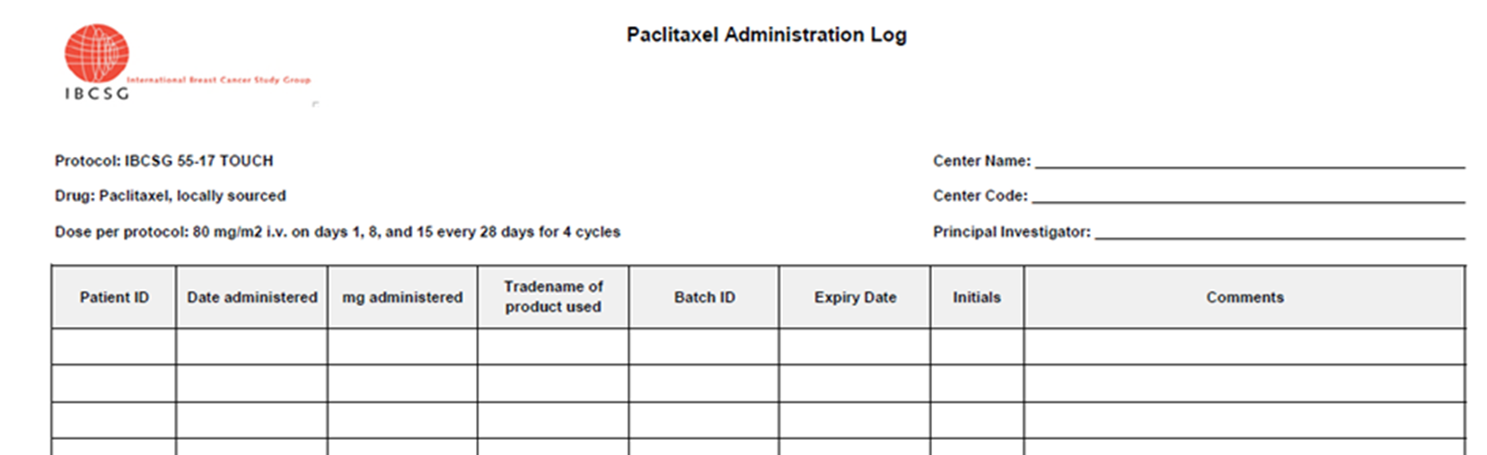
Paclitaxel (Arm A)
Will not be provided by IBCSG – to be sourced locally and prescribed to participating patients
Sites to label locally sourced paclitaxel with a trial label sticker provided in applicable country languages by IBCSG (Regulatory Office)
Sites to complete an Administration Log

Slide 74
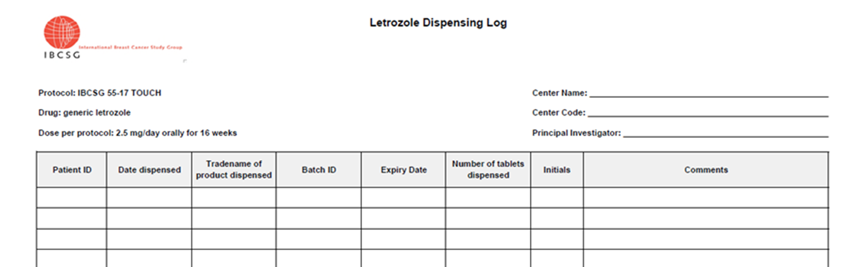
Letrozole (Arm B)
Will not be provided by IBCSG – to be sourced locally
Cost of letrozole generics will be reimbursed to sites by IBCSG
Sites to label locally sourced letrozole with a trial label sticker in applicable country languages provided by IBCSG (Regulatory Office)
Sites to complete a Dispensing Log

Slide 75
Letrozole Reimbursement
IBCSG shall refund the site for the costs of generic letrozole upon receipt of an original invoice.
Payments by IBCSG to site shall be made as follows:
Currency: EUR
Name of bank to be credited: [name of bank]
Account holder: [name of center]
IBAN: [insert IBAN]
BIC: [insert BIC]
To receive reimbursement for generic letrozole costs, you must send the original invoices to the IBCSG Coordinating Center
  Attn:
    Isabel Campus
    IBCSG
    Effingerstrasse 40
    CH 3008 Bern

Slide 76
Palbociclib (Arm B)
Experimental medicinal product
Product used: Ibrance®, marketed in Italy
Provided by Pfizer – IBCSG organized clinical labeling and distribution with Fisher Clinical Services GmbH (hereinafter called FCS) in Allschwil, Switzerland

Slide 77
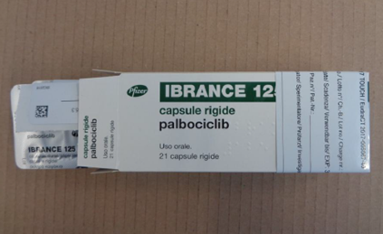
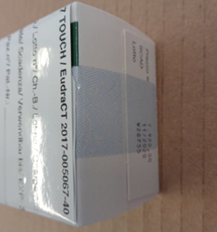
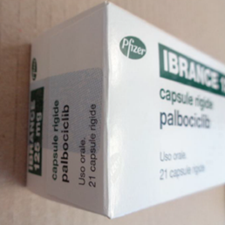
Palbociclib Photos
for reference only

Slide 78
Pertuzumab and Trastuzumab (Arm A & B)
Non-Investigational Medicinal Products (NIMPs) and used as background treatment
Product provided: Commercial drug product, packaged in blank boxes and applied with clinical label by F. Hoffmann-La Roche Ltd (hereinafter called Roche), Kaiseraugst in Switzerland.
Packaging, labeling and distribution is carried out by Roche

Slide 79
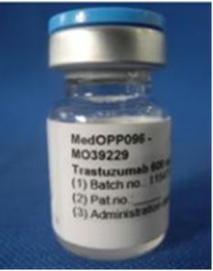
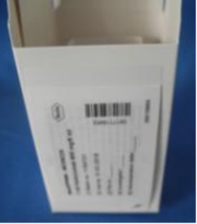
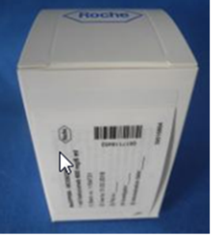
Trastuzumab photos
For reference only

Slide 80
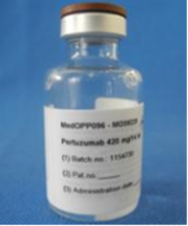
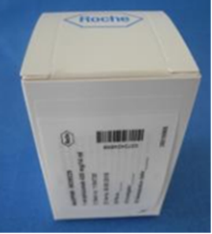
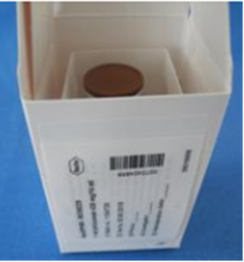
Pertuzumab photos
For reference only

Slide 81
Distribution of Palbociclib, Trastuzumab and pertuzumab
Palbociclib
Trastuzumab and Pertuzumab
Distributed by:
FCS Basel (CH) to sites in Switzerland
FCS Weil am Rhein (DE) to sites in Europe
Included in the shipment is also:
a packlist, on which to confirm the receipt
a temperature monitoring device
and an instruction sheet
FCS Shipping boxes and TempTale® can be discarded at site
Distributed by:
Roche Depot Kaiseraugst (CH) to sites in Switzerland
Roche Depot Grenzach (DE) to sites in Europe
Included in the shipment is also:
the Consigment Form (pack list), on which sites to confirm the date and time of receipt
Roche shipping boxes might be reusable. Follow the instructions included in the shipment.

Slide 82
AOR Pertuzumab & Trastuzumab
Temporary change in shipments to Swiss Sites
IMP cold chain shipments to sites in delivered by the Roche Depot Kaiseraugst in Switzerland will temporarily include a temperature logger.
Please handle the logger read out and temperature reporting according to the included instructions on the Transportation Data Sheet.
Please copy always drugsupply@ibcsg.org in any communication with Roche.

Slide 83
Receiving your initial supplies
Site ready to be activated → IBCSG Drug Supply Office orders a starter supply
Site/site pharmacist receives an email notification
Starter Supply content:
1 x ambient shipment | 1x cold chain shipment
2 boxes palbociclib 125 mg 1 box palbociclib 100 mg 1 box palbociclib 75 mg | 4 vials pertuzumab 420 mg 2 vials trastuzumab 600 mg

Slide 84
General Information on Ordering Re-supplies
No IVRS available
Sites to reorder via manual process, every time a patient is randomized.
Sites to track number of randomizations, inventory and expiry dates.
Expired medication has to be replaced, by ordering new supplies.

Slide 85
Recommendations on amounts to be ordered
After patient randomized to Arm A
After patient randomized to Arm B
Please order immediately:
5 x trastuzumab
6 x pertuzumab
Please order immediately:
4 x palbociclib* 125 mg
5 x trastuzumab
6 x pertuzumab
* Order 100 mg and/or 75 mg palbociclib only after a patient had a dose reduction. Order amount to complete respective patient treatment and refill starter supply.

Slide 86
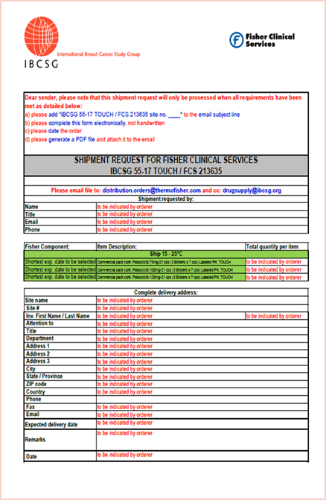
Submitting your Palbociclib re-supply orders
Complete the FCS order form template.
Follow the instructions on the form.
Send your order to:
  TO FCS: distribution.orders@thermofisher.com
  CC IBCSG: drugsupply@ibcsg.org

Slide 87
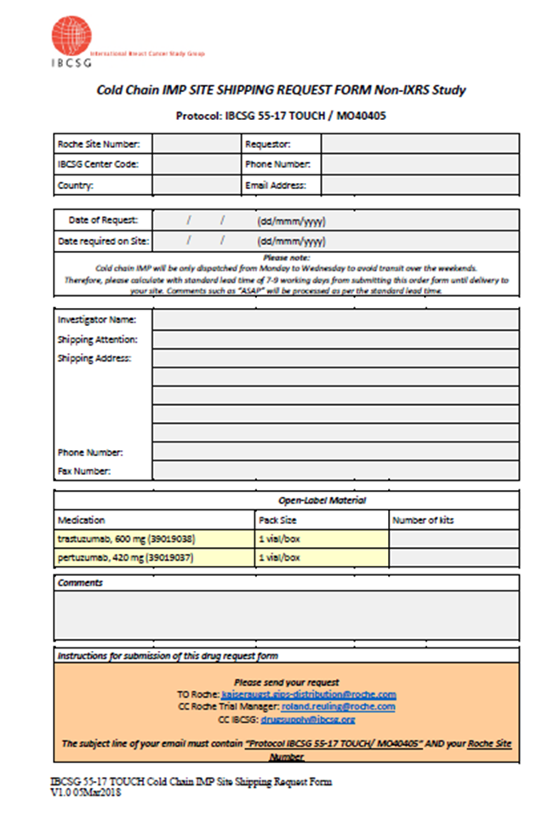
Submitting your pertuzumab and trastuzumab re-supply orders
Complete the Roche/IBCSG order form template.
Follow the instructions on the form.
Send your order:
  TO Roche: kaiseraugst.gips-distribution@roche.com
  CC IBCSG: drugsupply@ibcsg.org; and the Roche Study Manager roland.reuling@roche.com

Slide 88
Acknowledgement of receipt (AOR)
All shipments of palbociclib, pertuzumab and trastuzumab have to be confirmed to IBCSG upon receipt:
  Check the content
  Check the conditions
  Store the IMP under appropriate conditions
  Confirm receipt by completing shipping documents

Slide 89
AOR Palbociclib
Check TempTale® temperature monitoring device & download the PDF report (in any case):
If X = Alarm occurred, quarantine the palbociclib and complete the Palbociclib Temperature Deviation Form
If no Alarm occurred, palbociclib can be used

Slide 90
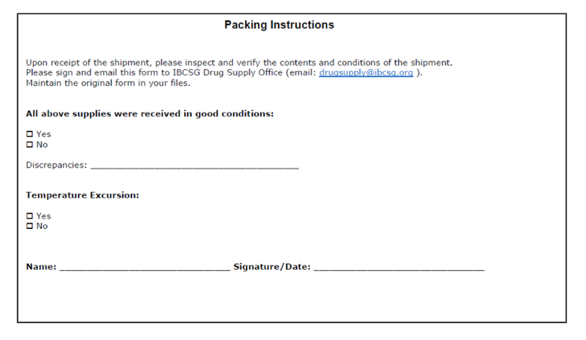
AOR Palbociclib
    Send TempTale® PDF & packlist (completed and signed!) to drugsupply@ibcsg.org . (if necessary, attach the Deviation Form)

Slide 91
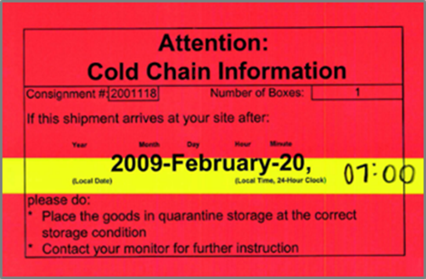
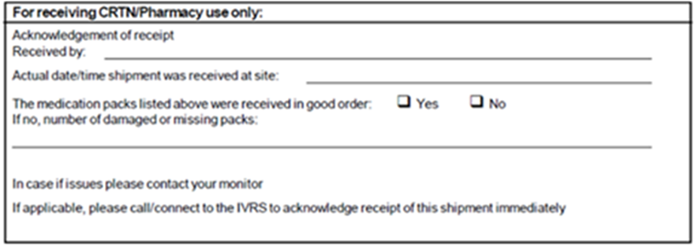
AOR Pertuzumab & Trastuzumab
Check latest acceptable date and time of arrival on the red label on the carton of the shipper.
Consignment Form (pack list) to be completed with date and time the shipment was received. Send it to drugsupply@ibcsg.org.

Slide 92
AOR Pertuzumab & Trastuzumab
If date /time is out of acceptable range or you inspect any irregularities:
    quarantine the shipment under appropriate storage conditions.
    complete the Roche IMP Deviation Form
    send it to global.imp-tempdev@roche.com, cc drugsupply@ibcsg.org; Roche Study Manager roland.reuling@roche.com.
    Roche will advise if medication is usable or not

Slide 93
Storage conditions
Store trial medication in a secure, limited-access location
Medication that expired, or not safe to dispense/administer must be stored well separated
Storage temperature must be monitored
All deviations from required conditions must be reported immediately
Palbociclib
Pertuzumab and Trastuzumab
+15°C - +30°C.
+2°C - +8°C.
Keep the vials in the outer carton.
Do not freeze.
Do not shake.

Slide 94


temperature deviations during site storage - general
Report deviations immediately, if not defined otherwise!
Affected medication, if not defined otherwise, has to be quarantined: well separated from usable study stock, until further usability confirmed.
  If confirmed affected drug is usable, release drug from quarantine for
  further use.
  If affected drug is not safe to use, destroy drug and order replacement.
Reporting procedure differs for palbocilcib and for pertuzumab/trastuzumab.
(details in following slides).

Slide 95
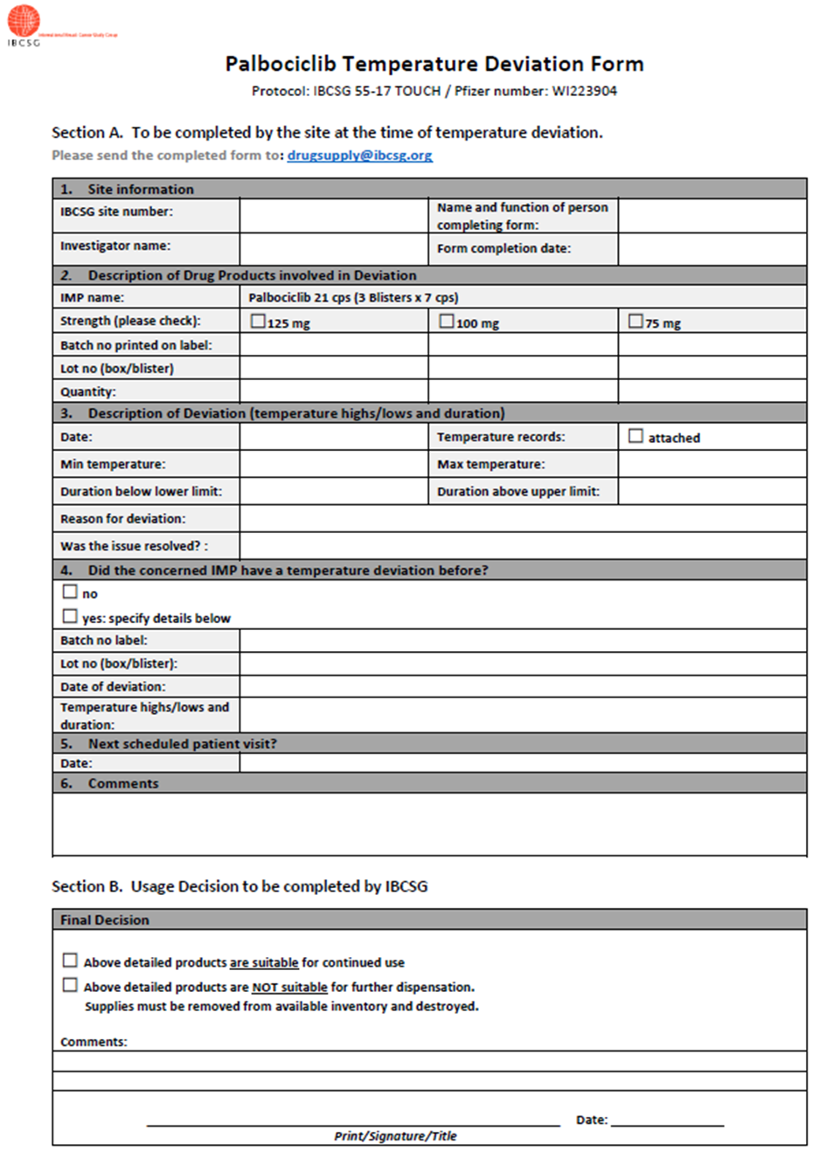
temperature deviation
Reporting Palbociclib
Report any excursion above 30° C and below +15°C
Complete all required fields of the IBCSG Palbociclib Temperature Deviation Form
Send the signed form to IBCSG Drug Supply Office drugsupply@ibcsg.org
Feedback IBCSG within 1-3 working days.

Slide 96
temperature deviation Pertuzumab and trastuzumab
Temperature deviation have to be handled as follows:
Type according to PD103 | Temperature was | Reporting via PD103 | Instructions | Quarantine
A | 0.5°C to 2.0°C (no time limit) 8.0°C to 15.0°C for ≤ 20 minutes | no | document excursion only in site temperature log | no
A | from 8.0°C to 15.0°C for > 20 min and ≤ 4 hours accumulative | yes | Send completed PD103 to drugsupply@ibcsg.org accumulate all deviations in this category | no
B | below 0.5°C above 15.0°C from 8.0 to 15.0°C for > 4 hours in a single event or accumulating events | yes | Report via Roche IMP Deviation Form PD103 to Roche global.imp-tempdev@roche.com and ETOP drugsupply@ibcsg.org Medication has to be quarantined until final assessment from Roche received | yes

Slide 97
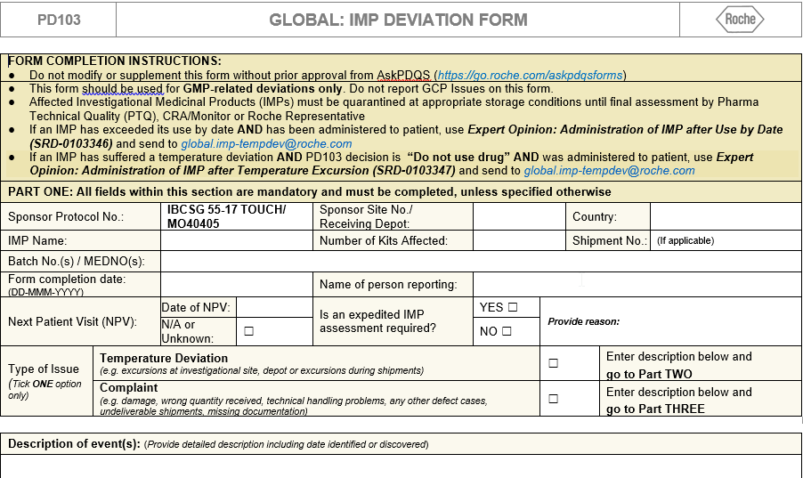
Trastuzumab & Pertuzumab
PD103 Roche IMP Deviation Form –
General information Page 1

Slide 98
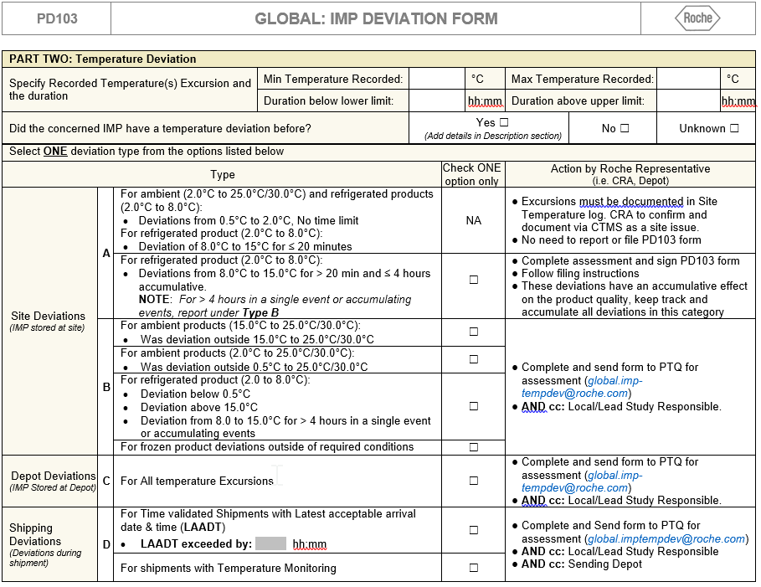
Trastuzumab & Pertuzumab
PD103 Roche IMP Deviation Form –
Temperature deviation Category page 2

Slide 99
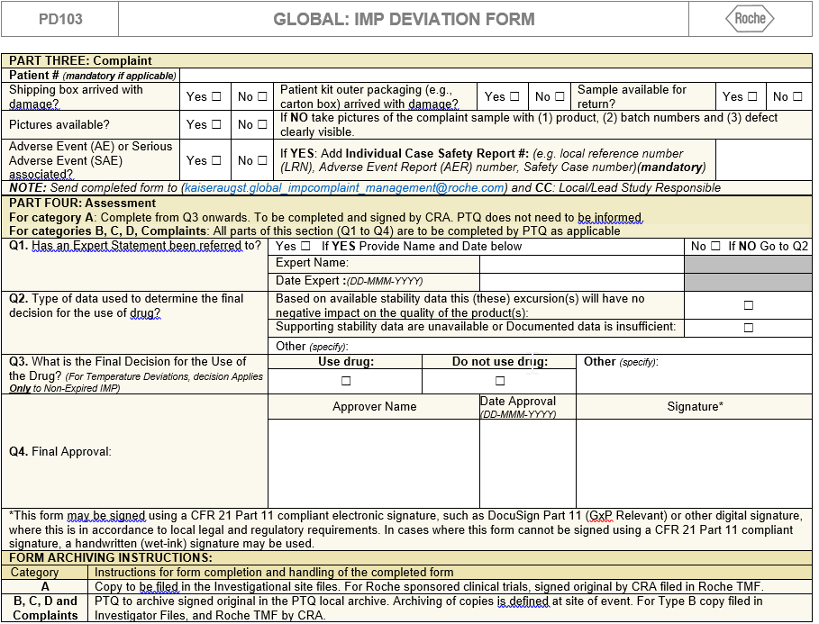
Trastuzumab & Pertuzumab
PD103 Roche IMP Deviation Form –
Product Complaints and assessment page 3

Slide 100
Complaints
Report any quality defect of palbociclib, pertuzumab and trastuzumab!
Affected medication must be stored quarantined, under the required storage conditions.
If possible, have the affected drug available for further examiniations and/or take pictures.
Defects of palbociclib have to be reported to Pfizer via IBCSG Palbociclib Product Complaint Form. Send completed form to drugsupply@ibcsg.org
Defects of pertuzumab and trastuzumab have to be reported via PD103
To: Roche kaiseraugst.global_impcomplaint_management@roche.com Cc: IBCSG drugsupply@ibcsg.org and Roche ICTM roland.reuling@roche.com.

Slide 101
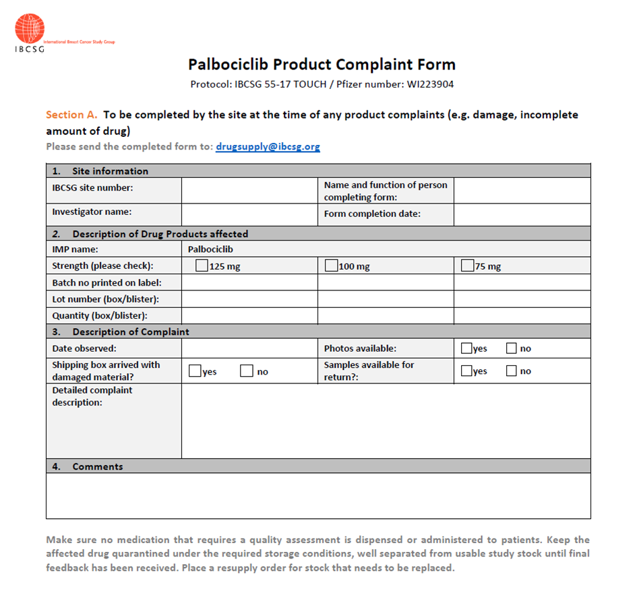
Product Complaint
Reporting Palbociclib
Complete all required fields in section A.
Send the form to drugsupply@ibcsg.org.

Slide 102
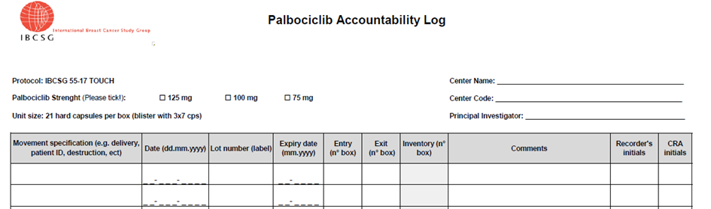
Drug Accountability Log
Document all drug movements for Palbociclib, Pertuzumab,Trastuzumab on the Accountability Log

Slide 103
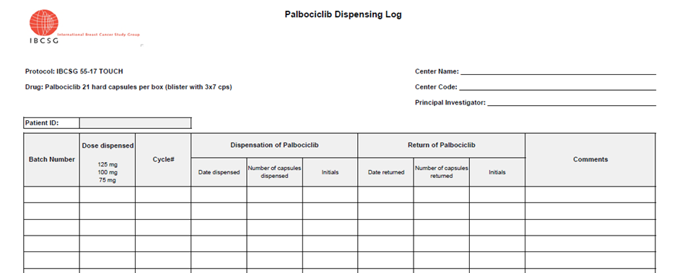
Dispensing Log Palbociclib
Capture palbociclib boxes dispensed to patients and number of capsules returned.

Slide 104
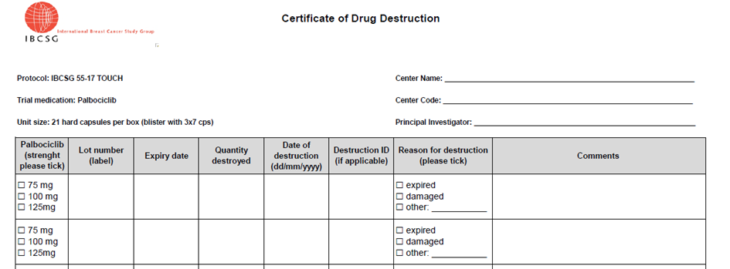
Destruction of palbociclib, pertuzumab and trastuzumab
Destruction approval for unused palbociclib, pertuzumab and trastuzumab from IBCSG is needed.
Sites can destroy per local requirements. If you are not allowed to destroy locally, contact drugsupply@ibcsg.org or your monitor.
Destruction has to be recorded on the respective drug Accountability Log & sites to send a destruction certificate to drugsupply@ibcsg.org

Slide 105
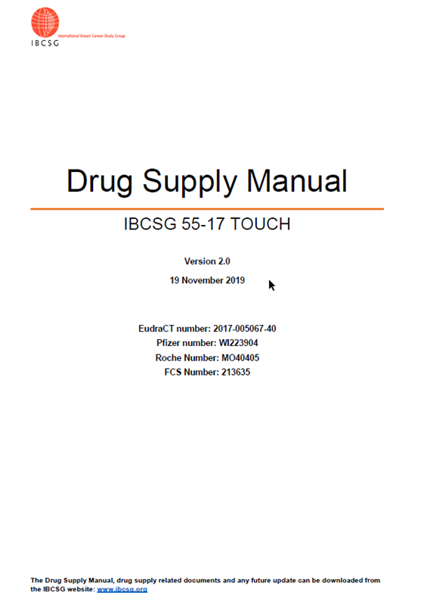
Drug Supply Manual
For details consult the Drug Supply Manual
It can be downloaded from the website www.ibcsg.org.

Slide 106
Contacts
IBCSG Coordinating Center, Bern, Switzerland: +41 31 511 94 00
IBCSG Drug Supply Office: drugsupply@ibcsg.org
Trial Coordination, Data Management Center, Amherst, USA: ibcsg55_touch@frontierscience.org

Slide 107
Reminders

Slide 108
Reminders
If it isn’t documented, it isn’t done.
Your DFexplore login is unique and is NOT to be shared with anyone for any reason!
Tab through the fields on the DFexplore forms to ensure they are completed correctly.
Report any staff or PI change to the trial team immediately. We will ensure the new team members have appropriate access.

Slide 109
Reminders
Members of the Study Team -- IBCSG Trial Coordinators, Data Managers, Monitors are great resources and are available to assist you throughout the trial.
The IBCSG website has valuable resources. Remember to login to make use of these.
The Data Manager’s Manual should be available to you while completing the CRFs.
IBCSG has created a prescreening log to assist with patient recruitment

Slide 110
Trial Contacts and resources
Email / Web Link | Recipient / Location | Purpose
ibcsg55_TOUCH@frontierscience.org | IBCSG DMC DMs and TCs | Questions regarding topics such as: Trial conduct Trial activation CRFs Eligibility
datafax.user.support@fstrf.org | IBCSG DMC User Support Department | Questions regarding issues with: DataFax software issues Faxing problems Confirmation of faxes received
https://www.ibcsgdmc.org/ibcsg/df/ | DataFax Support Web Application | Access to DF resources such as: Download DFexplore Download DFsend DFexplore/DFsend User Manuals Request access to DFexplore/DFsend Re-set password to DFexplore/DFsend Delete DF User
http://www.ibcsg.org | IBCSG website | Member access to resources such as: Protocol Reports CRFs (A & SAE forms only) Obvious Correction (OC) documents DataFax System information IBCSG Registration/Randomization Procedures Manual
FSTRF Randomization Help Desk Phone: +1 716 834 0900 Ext. 7301 Fax: +1 716 832-8437 Email: bc.helpdesk@fstrf.org | Frontier Science & Technology Research Foundation (FSTRF) Registration Randomization System | IBCSG Registration/Randomization System

Slide 111

Questions?

